Slide 1

Digital Portfolio
STUDENT NAME: Aswath K.A
REGISTER NO: 2428k0361 NMID: asbruaz2428k0361
DEPARTMENT: asbruaz2428k0361
COLLEGE: Bharathiyar University
1

Slide 2

PROJECT TITLE
STOP WATCH
2

Slide 3



AGENDA
Problem Statement
Project Overview
End Users
Tools and Technologies
Portfolio design and Layout
Features and Functionality
Results and Screenshots
Conclusion
Github Link
3/21/2024 Annual Review
3

Slide 4

PROBLEM STATEMENT
People often struggle to keep accurate track of time during daily tasks like studying, exercising, or experiments. Carrying a physical stopwatch everywhere is inconvenient and outdated. Most simple timers lack features like lap recording, reset, or exporting results. Hence, there is a need for a lightweight, digital stopwatch that is easy to use on any device.
4

Slide 5

PROJECT OVERVIEW
This project is a web-based stopwatch application built using HTML, CSS, and JavaScript. It allows users to start, stop, and reset the timer with a clean and interactive interface. The app also supports lap recording to track multiple intervals during a session. Users can export their lap data for further use or clear them when not needed. The stopwatch is lightweight, accessible, and can run directly in any modern web browser.
5

Slide 6

WHO ARE THE END USERS?
Students & Professionals – For managing study sessions, presentations, or productivity tasks.
Athletes & Fitness Enthusiasts – to track workout durations, running laps, or training intervals.
Researchers & General Users – for experiments, cooking, or any activity requiring precise time measurement.
6

Slide 7

TOOLS AND TECHNIQUES
Tools:
HTML – to structure the stopwatch interface.
CSS – to design and style the layout for a user-friendly look.
JavaScript – to implement stopwatch functionality (start, stop, reset, laps).
Techniques:
DOM Manipulation – for dynamically updating the time display and lap records.
Event Handling – for button clicks and keyboard shortcuts (Start/Stop, Lap, Reset).
Time Calculation – using performance.now() and requestAnimationFrame() for accurate timing.
7

Slide 8
POTFOLIO DESIGN AND LAYOUT
Cover Page – Project title, your details (name, course, college), and a simple design.
Introduction Page – Brief about the stopwatch project, its purpose, and importance.
Problem Statement & Objectives – Clear points highlighting the issue and what the project aims to achieve.
Design & Workflow – Flowchart or diagram showing how the stopwatch operates (Start, Stop, Lap, Reset).
Implementation & Tools – Description of technologies used (HTML, CSS, JS) with screenshots of the interface.
Conclusion & Future Scope – Summary of the project and possible improvements like countdown mode or mobile app version
8

Slide 9
FEATURES AND FUNCTIONALITY
Start/Stop Timer – Users can start and pause the stopwatch with a button or keyboard shortcut.
Reset Function – Allows resetting the timer back to zero instantly.
Lap Recording – Records multiple laps to track intervals during a session.
Export Laps – Users can download lap records in CSV format for later use.
Responsive Design – Works smoothly on desktops, laptops, and mobile browsers.
Keyboard Shortcuts – Spacebar to Start/Stop, L for Lap, and R for Reset, for faster control.

Slide 10
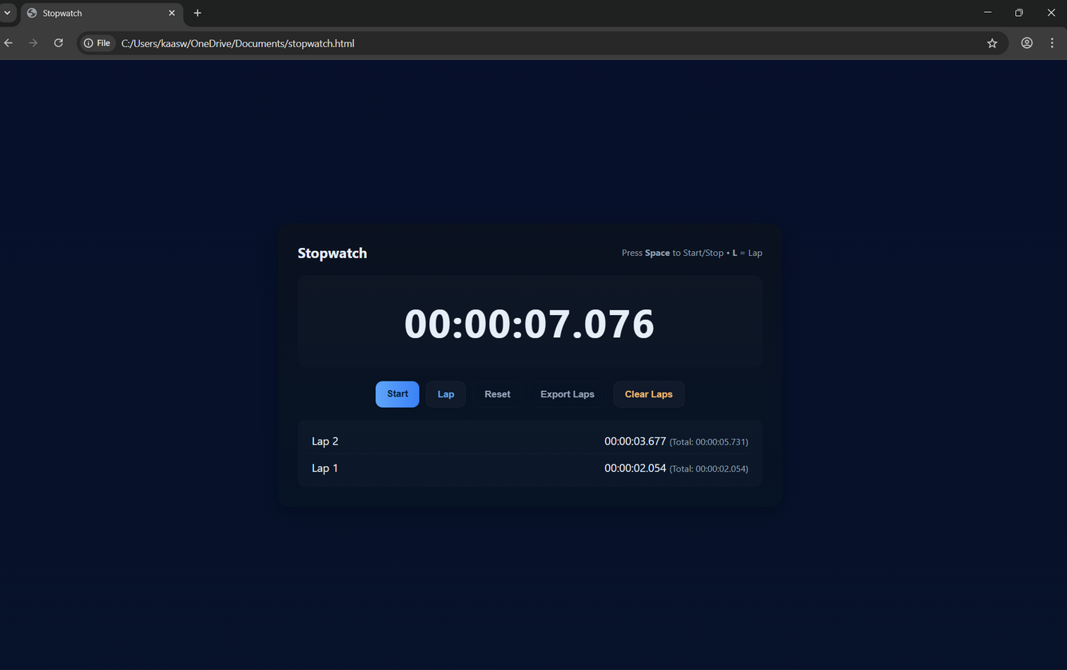

RESULTS AND SCREENSHOTS
3/21/2024 Annual Review
10

Slide 11
CONCLUSION
This project successfully delivers a simple yet powerful digital stopwatch. It helps users accurately track time for studies, workouts, and daily tasks. The clean interface and features like laps and reset make it user-friendly. Exporting lap data adds extra usefulness beyond a normal timer. Overall, the project shows how basic web technologies can solve real-life needs effectively.
11

